Slide 1
Analysis Of World’s University Ranking
By: Dikshya Upreti
Asmita Bamma
Alisha Baral

Slide 2
About the dataset
We are working with university ranking dataset. There are informations about 2000 universities globally.
This dataset has information on various university globally. University are ranked on several aspects like research,faculty,employability,education and more.
We will be analyzing about factors that affect the overall ranking of universities.

Slide 3
Research questions
What are the top universities based on their education, research and employment success rate in USA? And what are the top three ranked universities in USA?
Where are the top 50 ranked universities located in?
What factor is most important overall for high university ranking?
What are the countries with 90+ score globally?
Target Audience
Students looking for universities in the USA and all over the world based on factors like education, research and employment rate.

Slide 4

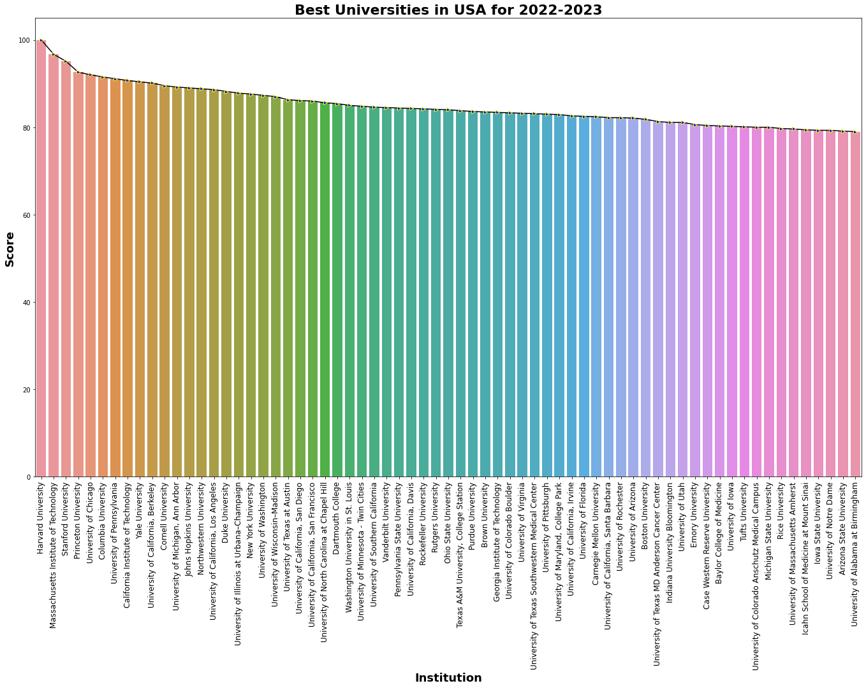
What are the top universities based on their education, research and employment success rate in USA?
This bar plot shows top 50 ranked universities in USA.
The bar plot is in descending order.
Harvard University is the highest ranked university in USA. with a perfect score of 100.

Slide 5
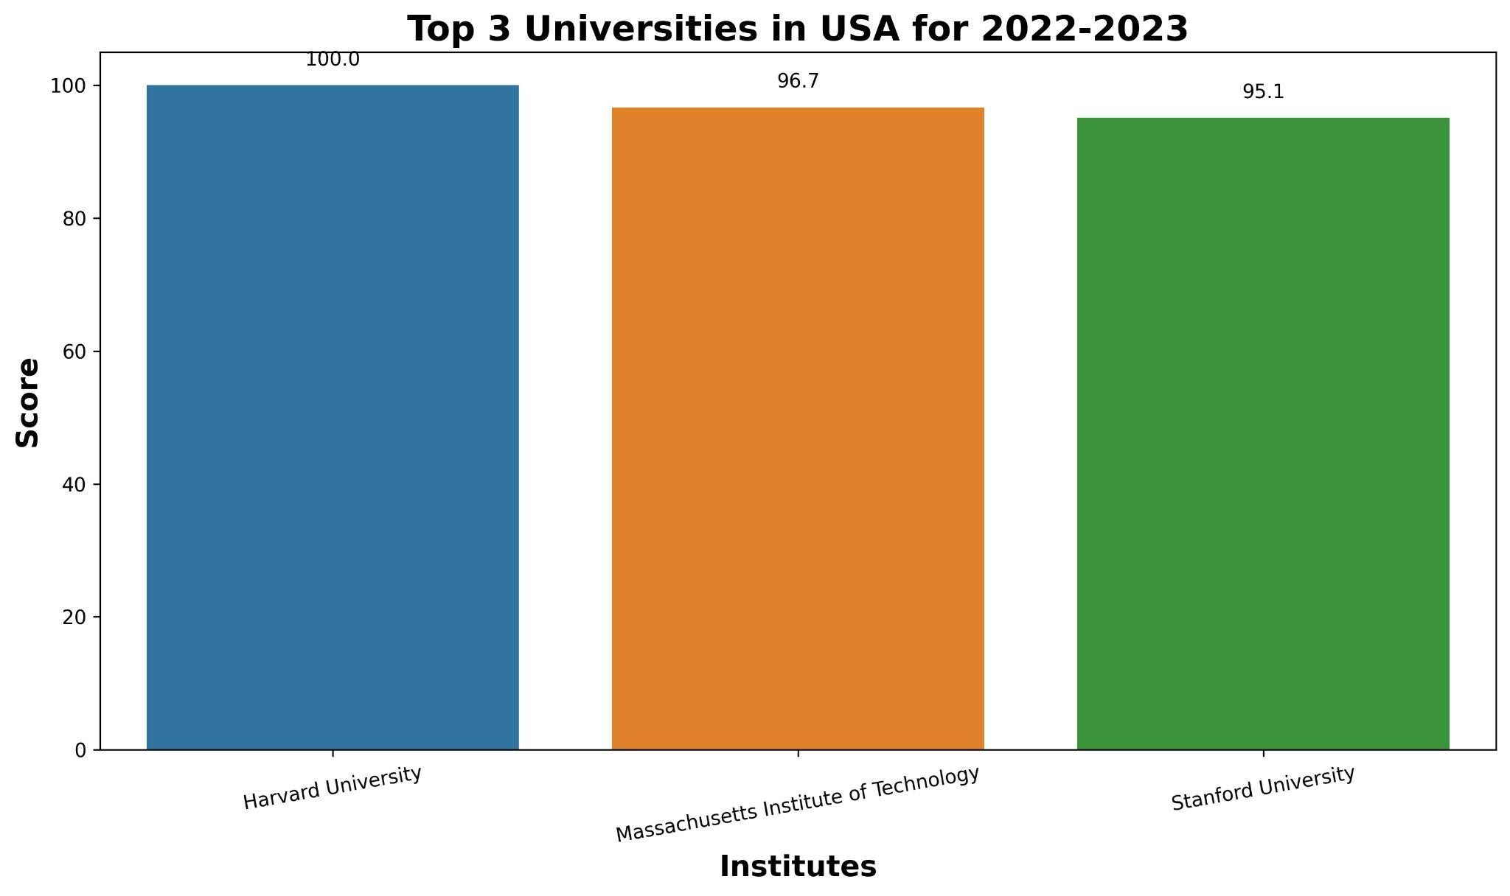
2. What are the top three ranked universities in USA?
Harvard is the highest rank university in USA .The only university globally with perfect score.
The bar plot is in descending order.
Seaborn is used to create this graph with well defined labels.

Slide 6
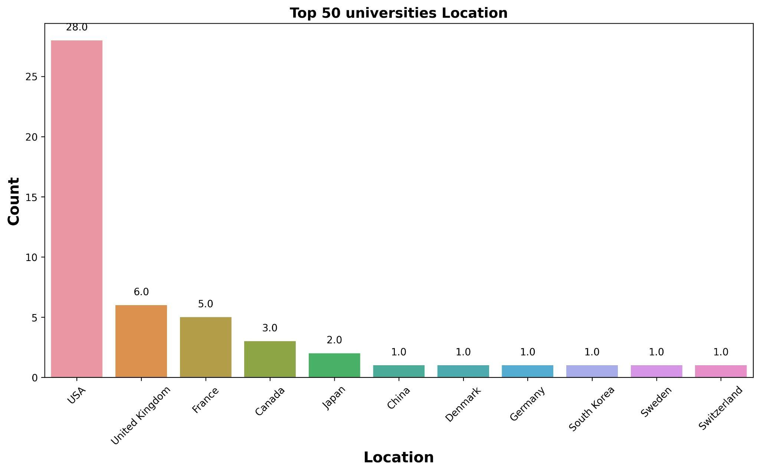
2. Where are the top 50 ranked universities located in?
USA has 28 most high ranked universities.
UK has 6 most high ranked universities.
Asia relatively has less universities that are ranked in top 50.

Slide 7
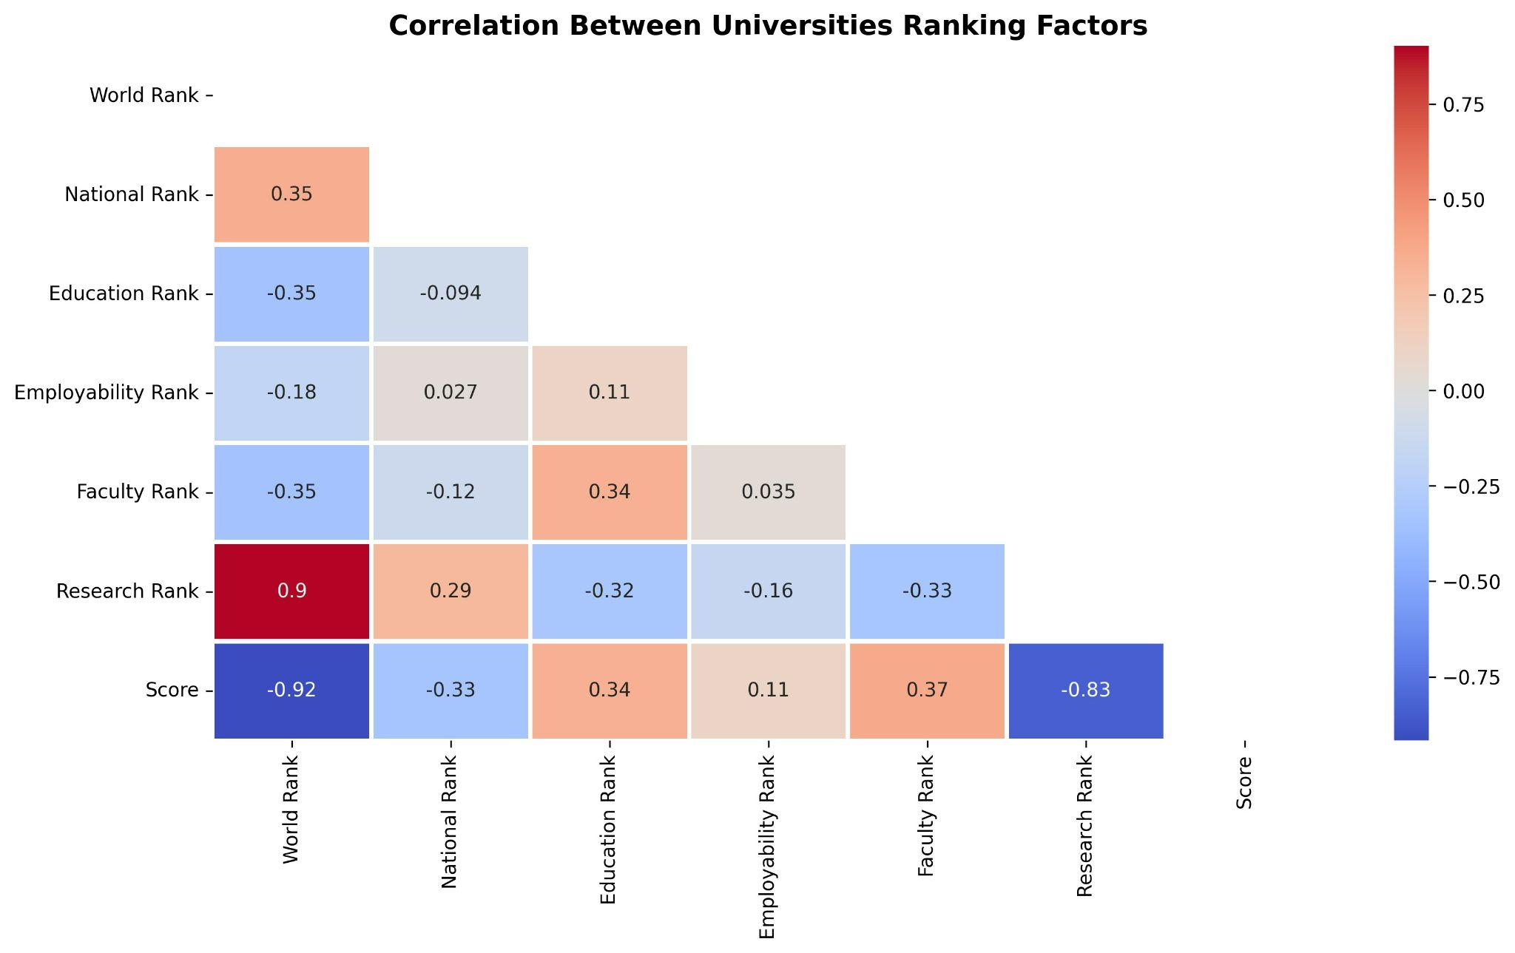
3. What factor is most important overall for high university ranking?
This heatmap shows correlation between universities and their ranking factors.
Research rank has the highest correlation for worldwide university ranking with z score of 0.9.
Mask technique is used to remove mirror effect in this heatmap.

Slide 8
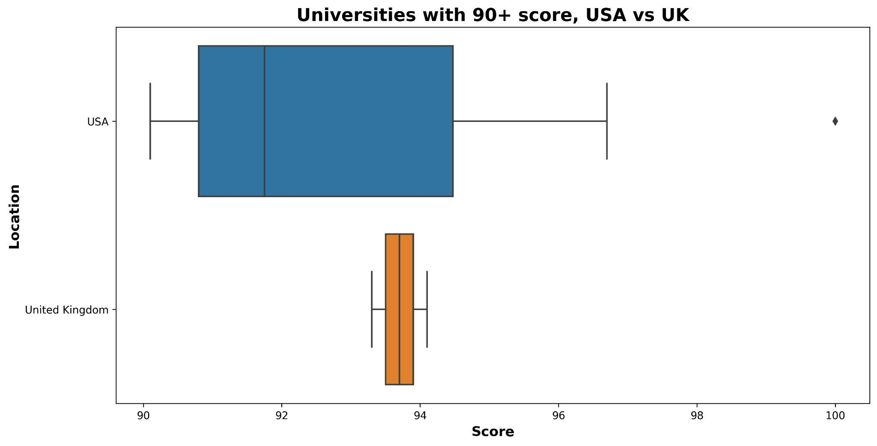
4. What are the countries with 90+ score globally?
Among 2000 universities in this dataset ,there are only 12 universities globally with score above 90.
Box and whisker plot here compares the score statistics of USA and UK.
There are 10 USA universities and 2 UK universities that have scored above 90.

Slide 9
Final Analysis
Question 1: The first bar graph gives us the names for best universities in USA, 2022-2023. The bars shows us the difference between each universities with respect to their final score. The second graph shows top three US universities.Students willing to study in USA could take advantage of the graphs to compare top universities.
Question 2: The second bar gives top 50 universities locations present all over the world. US ranks 1st with 28 out of 50 best, followed by UK with 6 and France with 5 top universities. Students could utilize this analysis for choosing universities based on location.
Question 3: The heatmap shows both positive and negative correlation among the variables. Research rank has the highest correlation with world rank with z score of 0.9. So, research contributes hugely in universities world ranking.
Question 4: USA has very impressive list of universities. Only two UK universities have overall score of over 90.

